Slide 1
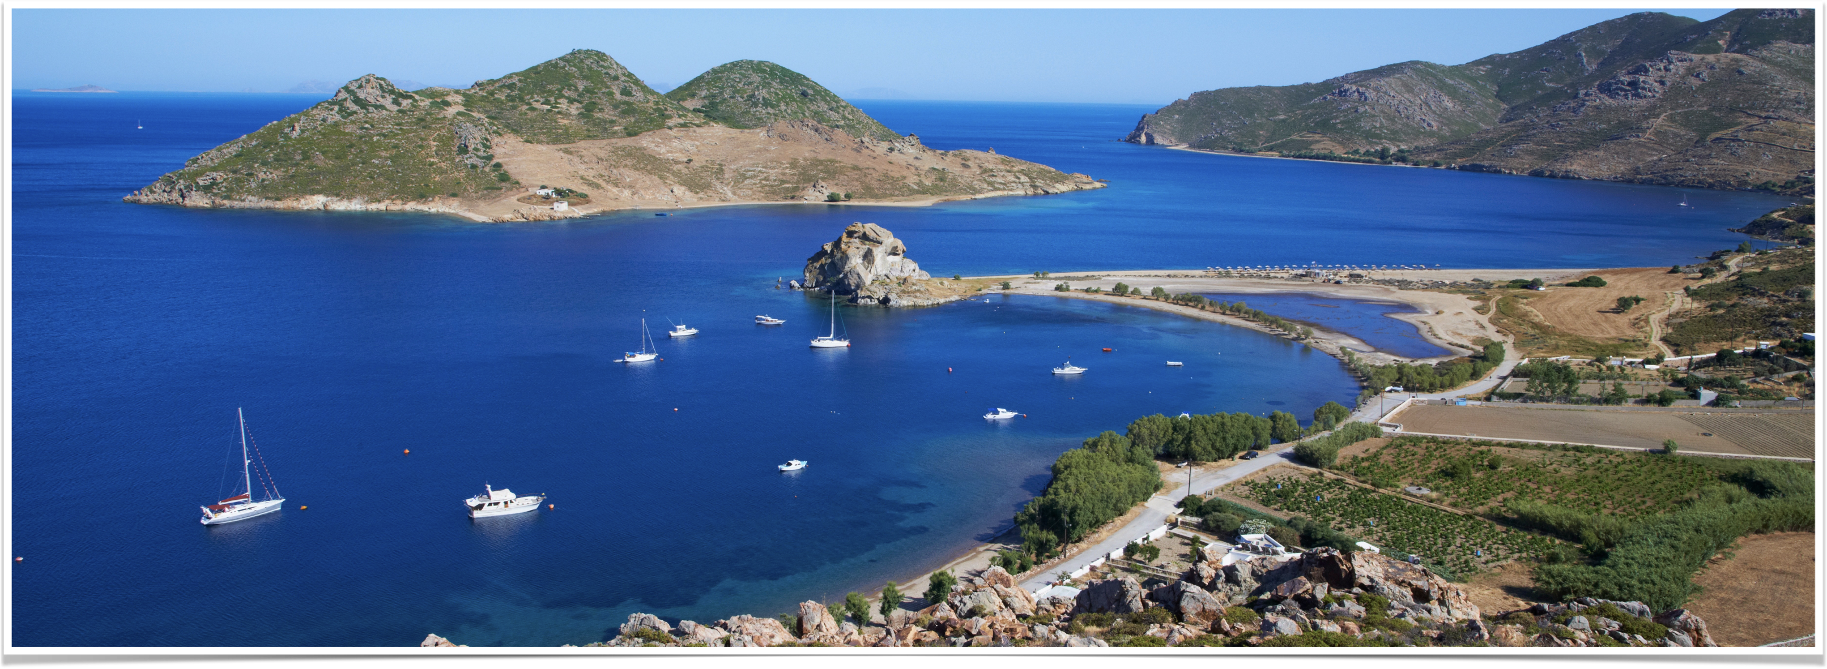
The Revelation of Jesus Christ
Introduction and Vision #1 (1:9-4:1)

Slide 2
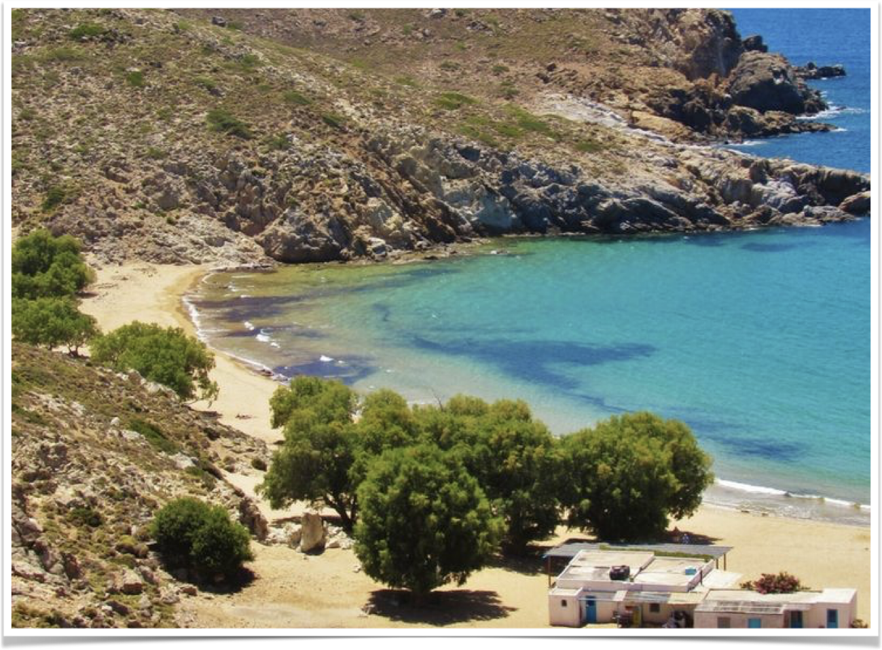
Tonight’s study
Introduction to Revelation
A quick look at the first vision in chapter 1
Start Vision #2 which begins in 4:1

Slide 3
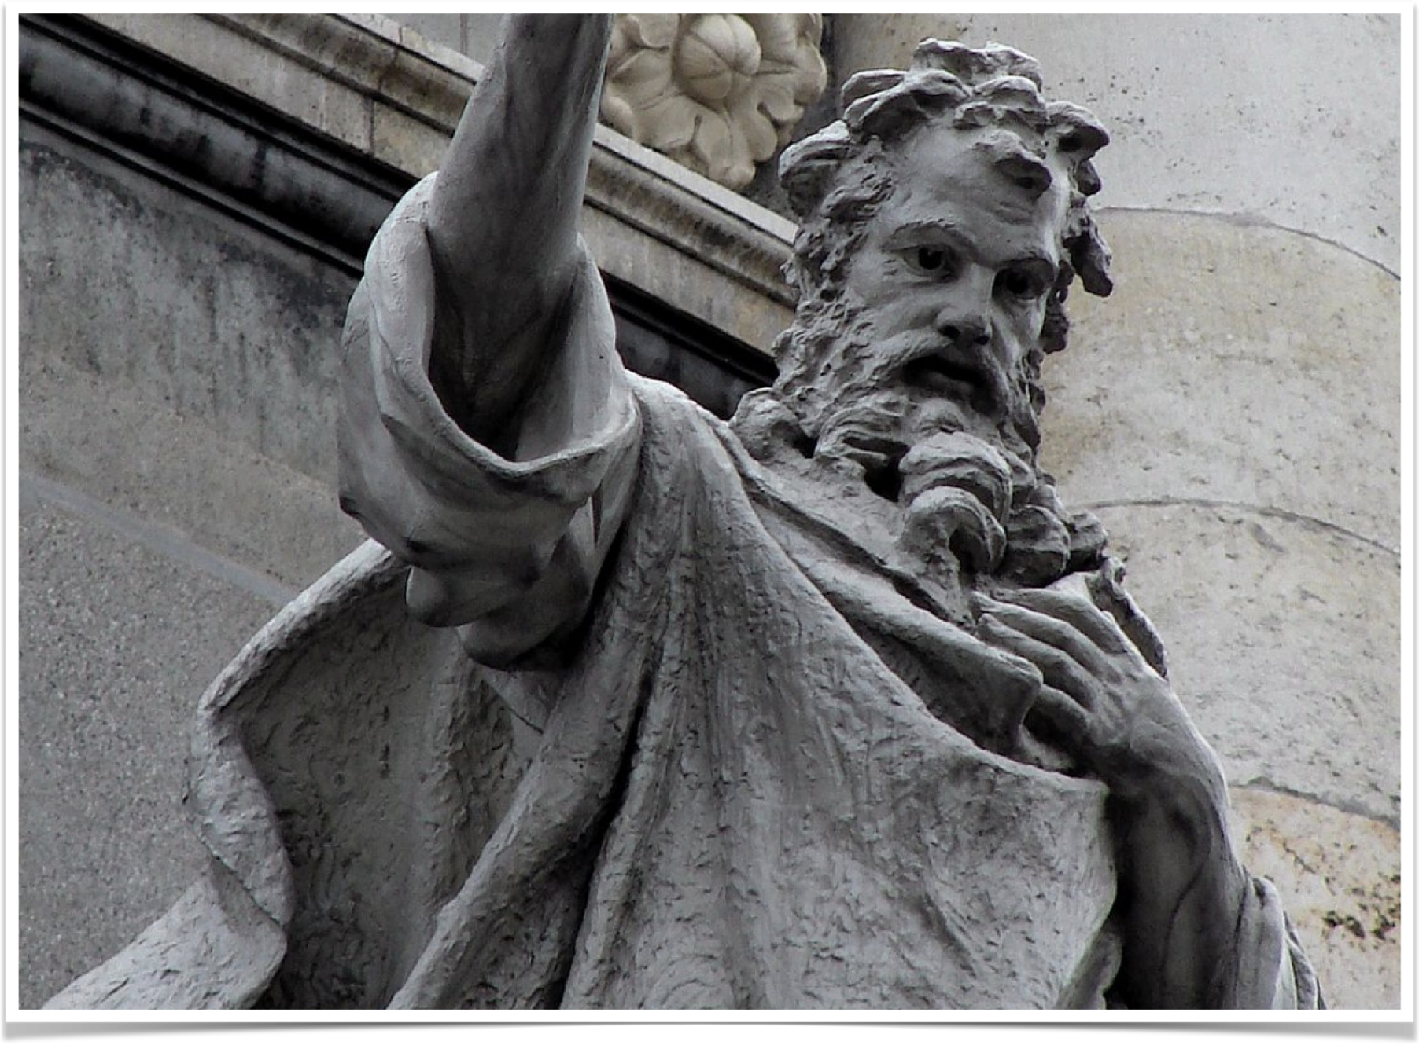
When was Revelation written?
Testimony of Irenaeus:
  Close associate of Polycarp
  Nero Claudius Domitianus (Domitian): 81-96 A.D.
  95-96 A.D.
Eusebius: John sentenced during reign of Domitian

Slide 4
The purpose of Revelation
Written during intense persecution
Assures the faithful of Jesus Christ’s victory — Jesus wins!
A message of hope
Strengthens the faith of those who look back on its fulfillment

Slide 5
Structure of Revelation
See the “General Outline of Revelation” in your study guide packet
A short prologue followed by six visions
Each vision begins with John seeing a sign from heaven
Each vision ends with proleptic view of the final judgment
Each vision focuses on its own themes

Slide 6
Interpreting revelation

Slide 7
Revelation 1:1, “signified”
John 12:32-33, “And I, if I am lifted up from the earth, will draw all peoples to Myself." (33) This He said, signifying by what death He would die.”
See also Acts 11:28
Revelation is like Daniel, Ezekiel, and Zechariah — books with extensive symbolism

Slide 8
What portions are symbolic?
1:10, “…in the Spirit on the Lord’s Day” - chapter 1 full of symbols (e.g. 1:20)
What about chapters 2-3?
Notice 4:1-2, “After these things I looked, and behold, a door standing open in heaven. And the first voice which I heard was like a trumpet speaking with me, saying, "Come up here, and I will show you things which must take place after this." (2) IMMEDIATELY I WAS IN THE SPIRIT; and behold, a throne set in heaven, and One sat on the throne.”
John remains in the Spirit (e.g. 17:3 and 21:10, “carried away in the Spirit”)

Slide 9
How do we interpret the symbolism?
God intends Revelation to be understood: see Revelation 1:3
Symbolism conceals message from all except the dedicated: see Revelation 13:18, 17:9
Genesis 41:16, “So Joseph answered Pharaoh, saying, ‘it is not in me; God will give Pharaoh an answer of peace.’"
  Use God’s book to interpret God’s symbols
See “Revelation Table of Symbols”

Slide 10
Remember the audience
See Revelation 1:4
Cities in the Roman Empire persecuted by that power
Affected by or contribute to apostasy — see Acts 20:30 and Revelation 2:2
Message of hope for these churches

Slide 11
prophecy forecasts historical events
OT Examples
  Isaiah 23 predicts the judgment of Tyre
  Nahum predicts destruction of Ninevah
  Daniel 11 predicts internal strife in the Greek empire
Revelation also predicts historical events
Prophecies not fully understood until after they are fulfilled - see 2 Peter 1:19

Slide 12
“Continuous historical” View
Fulfillment began soon after writing (see 1:1, “things which must shortly take place”)
Seals, trumpets, and bowls point to successive, chronological, historical events
Bible’s testimony stretches from creation - judgment day
Primary mode of interpretation among Protestants from 16th - early 20th centuries
See “Historical Progression of Revelation”

Slide 13
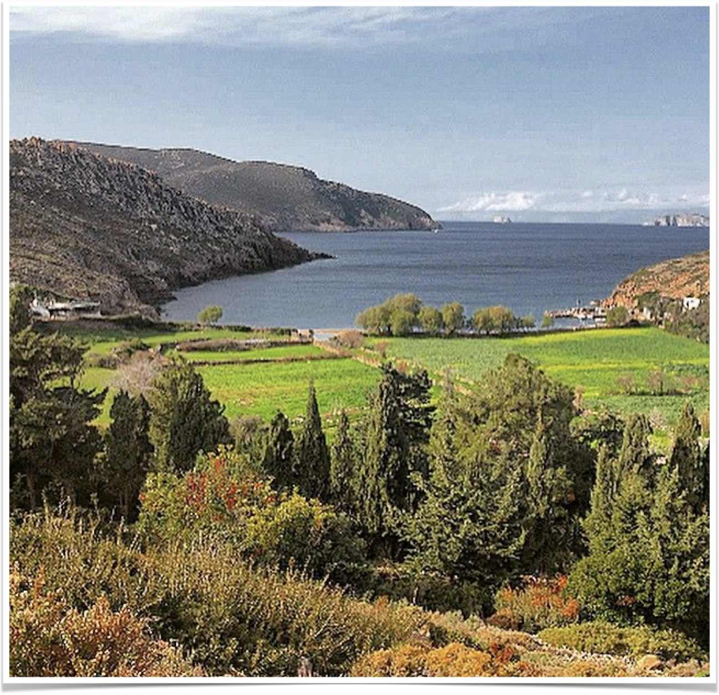
Revelation 1
“I, John, both your brother and companion in the tribulation and kingdom and patience of Jesus Christ, was on the island that is called Patmos for the word of God and for the testimony of Jesus Christ. I was in the Spirit on the Lord's Day, and I heard behind me a loud voice, as of a trumpet…”

Slide 14
John sees a glorified christ
Verses 12-13
  Seven golden lamp stands (seven churches of Asia, see very 20)
  Jesus (Son of Man) standing in the midst of lampstands (Jesus in fellowship with churches)
Verses 14-15: Jesus crowned with heavenly glory

Slide 15
Verse 16
Seven stars in right hand (seven messengers of the churches, see verse 20)
“…out of His mouth went a sharp two-edged sword” — word of God (see Hebrews 4:12)
“…countenance was like the sun”
  2 Corinthians 3:13-18: glory of the Lord reflected in the face (countenance)
  “…dwelling in unapproachable light” (1 Timothy 6:16)

Slide 16
Verse 17, “I am the First and Last”
Compare with 1:8 and 1:11
Language that describes divinity
  Alpha and omega = first and last letters of the Greek alphabet
  See Genesis 17:1, Isaiah 44:6
  “…who is and who was…” — unique to Revelation (see 1:4, 11:17, 16:5)
Son of Man AND the Son of God

Slide 17
Verse 18, “And I have the keys of Death and Hades.”
Hades — dwelling place of the dead
“…keys of Death and Hades” — Jesus has the authority to open and shut, to deliver or imprison (see Matthew 16;18)
Last enemies destroyed (see Revelation 20:14 cf with 1 Corinthians 15:26)

Slide 18
Verse 19 - past, present, future
General description of prophecy
  “…things which you have seen” - past tense (chapter 1)
  “…things which are” - the present situation (e.g. seven churches in chapters 2-3)
  “…things which will take place after this” - visions of the future (chapters 4-22)
Five books of Moses are another example of prophecy in its fullest form
Parallel to “who was and who is and who is to come”

Slide 19
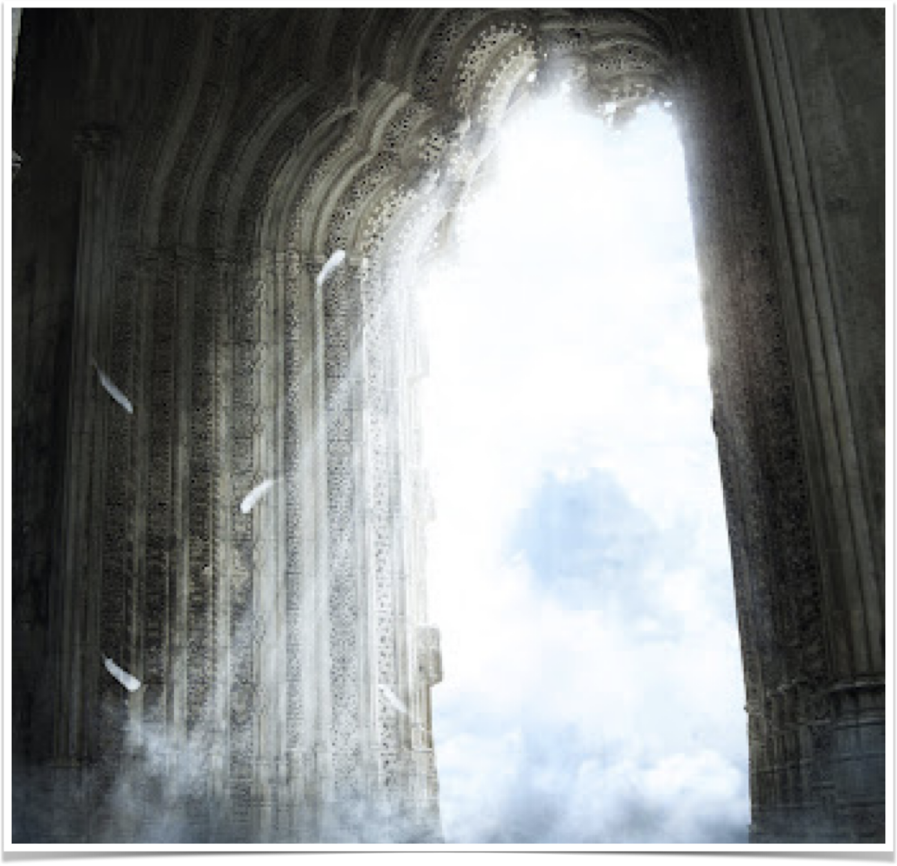
Revelation 4
“After these things I looked, and behold, a door standing open in heaven. And the first voice which I heard was like a trumpet speaking with me, saying, ‘Come up here, and I will show you things which must take place after this.’”

Slide 20
“…a door standing open in heaven”
“…first voice I heard” — the voice of Jesus (see 1:10-11)
“I will show you things…” (see 1:1)
  God to Jesus, Jesus to John
“…things which must take place after this” (remember 1:19)
  4:2 onward concerns future events

